Slide 1
Fourier Transform

Slide 2



Definitions:
The fourier transform of a function f(x) is defined by
The fourier cosine transform of a function f(x) is defined by
The fourier sine transform of a function f(x) is defined by

Slide 3



Inversion Formula:
If F(s) is fourier transform of f(x) then
Inversion formula for fourier cosine transform is
Inversion formula for fourier sine transform is
Note: Write the fourier transform pair.

Slide 4



Fourier Integral theorem:
Let f(x) be a function which satisfies the Dirichlet’s conditions
in every interval (-l, l) then

Slide 5
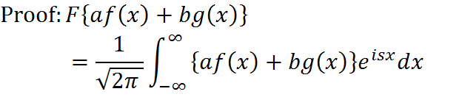
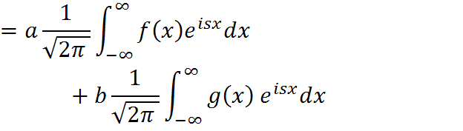

Properties:
Fourier transform is linear. (i.e)

Slide 6

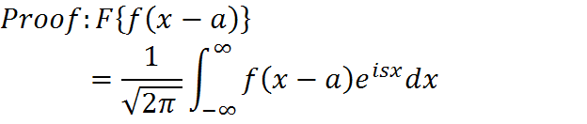




Shifting Theorem
x-a=y dx=dy

Slide 7
Change of scale property
Proof:
Put ax=t
a dx =dt

Slide 8

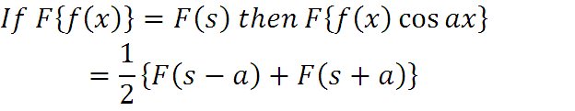
Proof:

Slide 9


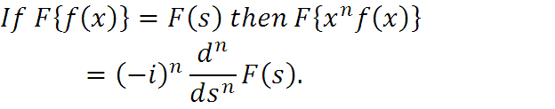
Property:

Slide 10
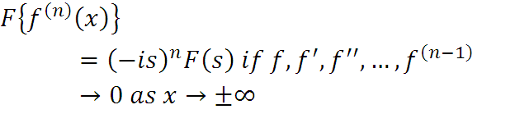


F.T of derivatives
Properties regarding Fourier cosine and sine transformations

Slide 11





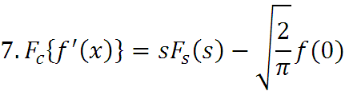

Slide 12

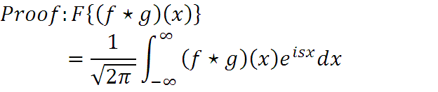

Definition: The convolution of two functions f(x) and g(x) is
defined by
State and prove convolution theorem for fourier transform

Slide 13





(By changing the order of integration)
(By shifting theorem)

Slide 14





Slide 15




State and Prove Parseval’s identity for fourier transform
Let x=-y
dy=-dy

Slide 16



Proof of the main theorem:
By convolution theorem

Slide 17





Slide 18






Results:

Slide 19
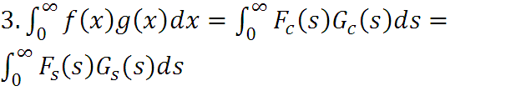


Results

Slide 20






Problem 1: Find the fourier transform of
where a is a positive real number. Hence prove that

Slide 21

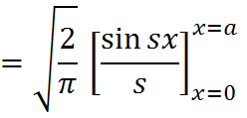
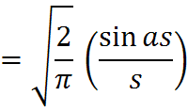

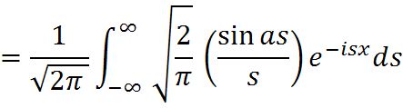
By inversion formula

Slide 22







Slide 23

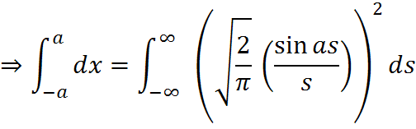

By parseval’s identity

Slide 24




Slide 25







Slide 26








Slide 27


Definition: If a transformation of a function f(x) is equal to f(s)
then the function f(x) is called self reciprocal.

Slide 28




Problem 4: Find the fourier transform of
Hence prove that

Slide 29
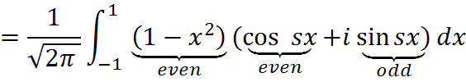





Slide 30




By Fourier inversion formula

Slide 31


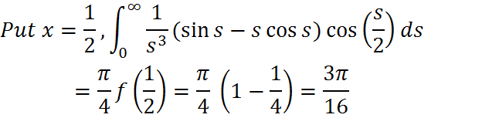

By parseval’s identity

Slide 32




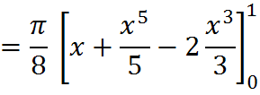


Slide 33




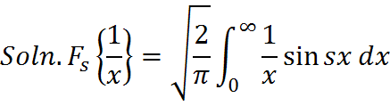



Slide 34
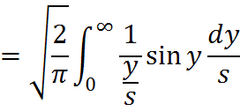
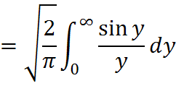
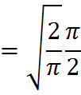


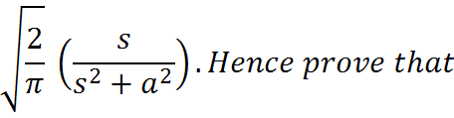


Slide 35
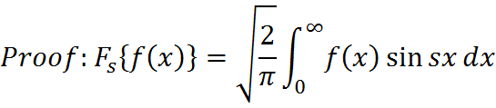
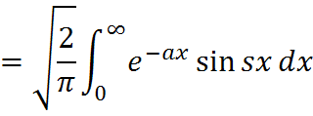
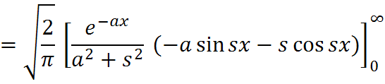
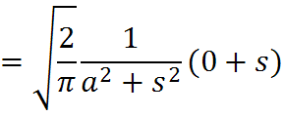
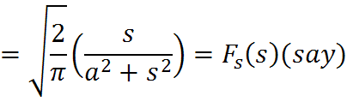

Slide 36
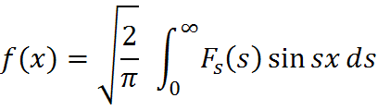
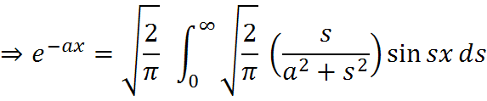


By inversion formula for fourier sine transform

Slide 37

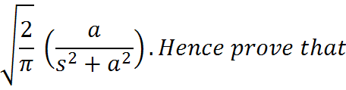

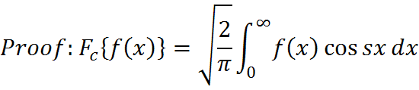
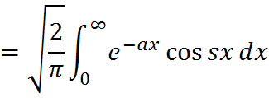

Slide 38
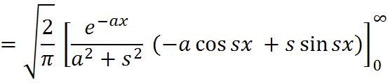
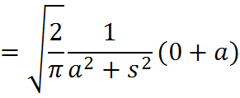
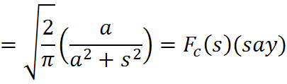
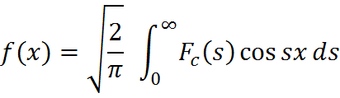
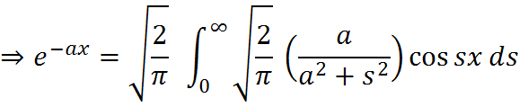
By inversion formula for fourier cosine transform

Slide 39





Slide 40
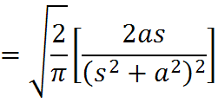

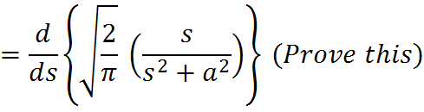
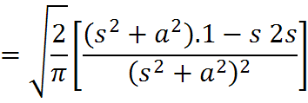
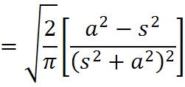

Slide 41


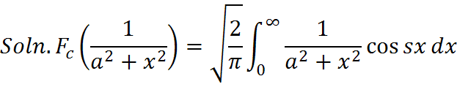
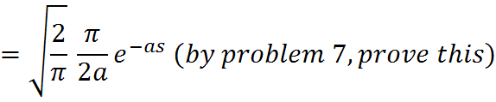


Slide 42
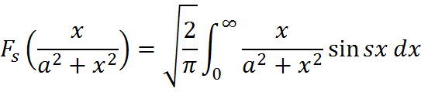
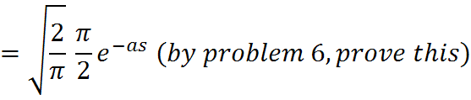




Slide 43

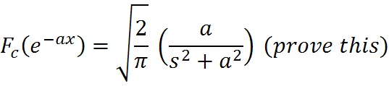
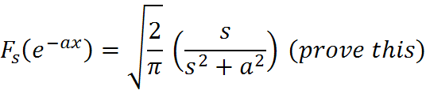





Slide 44
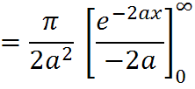






Slide 45

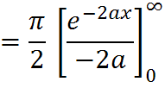




Slide 46


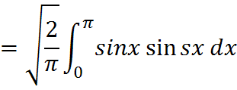
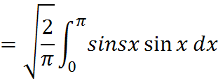


Slide 47






Slide 48




Slide 49
Using Parseval’s identity, we have

Slide 50
Put s = 2t
ds = 2dt

Slide 51
Problem 13: Find the Fourier transform of

Slide 52
Hence deduce that
Solution:

Slide 54
Using inverse Fourier transform, we have

Slide 55
Put as = 2t
ads = 2dt

Slide 56
Using Parseval’s identity, we have
Put as = 2t
ads = 2dt

Slide 58
Problem 14:Find the Fourier sine and cosine transform of
and hence prove that
is self reciprocal under both Fourier sine and cosine transforms.
Sol. Consider

Slide 59
since
Equating R.P and I.P, we get

Slide 61
Hence
is self reciprocal under Fourier sine and cosine transforms.
Problem 15: Use transform methods to evaluate

Slide 64
Problem 16:Using transforms evaluate

Slide 66
Problem 17: Using Parseval’s identity, calculate

Slide 67
Using Parseval’s identity for Fourier cosine transform, we have

Slide 68
Using Parseval’s identity for Fourier sine transform, we have

